Slide 1

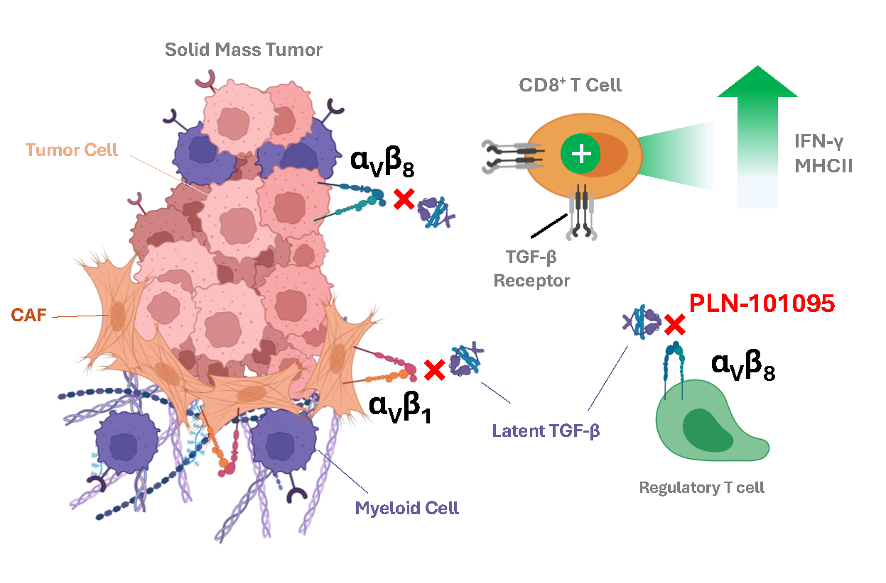
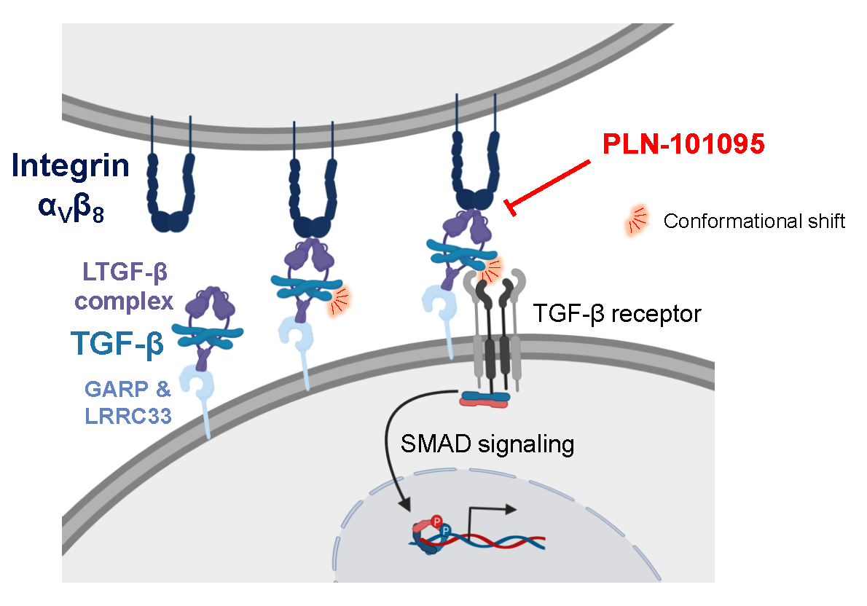
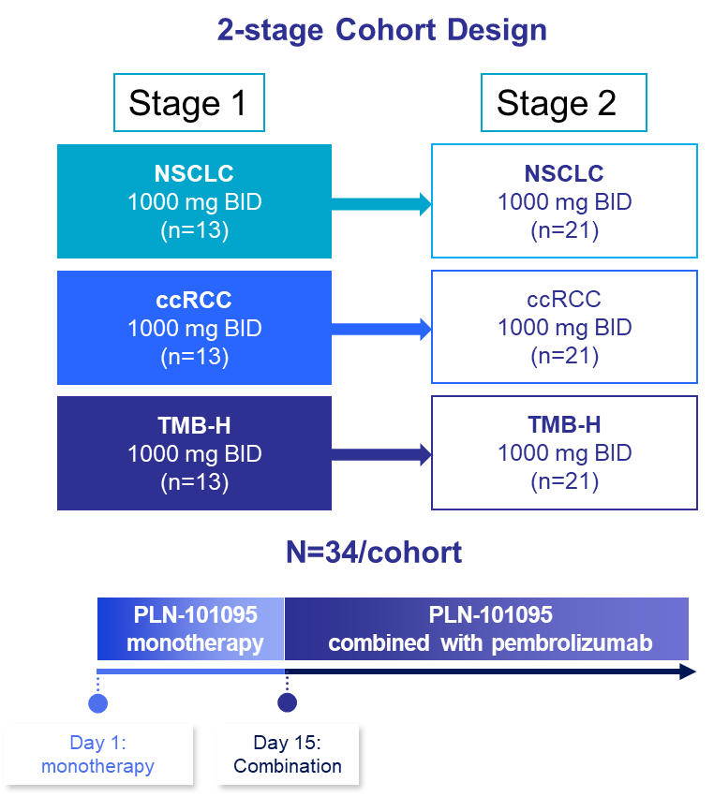

Trial in Progress: Cohort Expansion of a Phase I Study of PLN-101095, a First-in-Class Dual α_{v}β₈ /α_{v}β₁ Integrin Inhibitor, in Combination with Pembrolizumab in Patients With Advanced Solid Tumors Refractory to Immune Checkpoint Inhibitors
TPS2690
Timothy A. Yap, MBBS, PhD, FRCP¹; James L. Gulley, MD, PhD²; Manish Sharma, MD³; Chris N. Barnes, PhD⁴; Martin Decaris, PhD⁴; Jenny Amaya-Amaya, MD, MSc⁴
¹The University of Texas MD Anderson Cancer Center, Houston, TX, USA; ²NCI Center for Cancer Research, Bethesda, MD, USA; ³START Midwest, Grand Rapids, MI, USA;
⁴Pliant Therapeutics Inc., South San Francisco, CA, USA
BACKGROUND
Although single-agent immune checkpoint inhibitors (ICIs) show antitumor activity across multiple tumor types, only a minority of patients respond and fewer achieve durable responses,^{1,2} highlighting the need for additional immunomodulatory strategies to
improve efficacy
Transforming growth factor β (TGF-β) drives immunosuppression, T-cell exclusion and fibrogenesis in solid tumors, contributing to acquired ICI resistance^{3,4}
  The integrins α_{v}β₈ (expressed by tumor and/or immune cells) and α_{v}β₁ (expressed by cancer-associated fibroblasts) activate latent TGF-β in the tumor microenvironment (TME) to promote immune escape^{3,4}
PLN-101095 is a first-in-class, oral, dual α_{v}β₈/α_{v}β₁ inhibitor that is designed to block integrin α_{V}β₈ and α_{V}β₁–driven activation of TGF-β locally in the TME^{3,5} (Figure 1)
Inhibition of α_{v}β₈ and α_{v}β₁ integrins blocks the activation of TGF-β in solid tumors to reduce immunosuppression, leading to a new or reinvigorated cancer immune response (Figure 1)^{3,5}
PLN-101095 differs from past efforts to systemically target the active TGF-β cytokine
or TGF-β receptor kinase, which have produced limited antitumor responses⁶
  Latent TGF-β can signal through its receptors following integrin-induced localized conformational shifts, without the active cytokine being released from the
  latent complex⁷
  PLN-101095 prevents integrin binding to the latent TGF-β complex, providing a novel
  point of intervention immediately upstream of the TGF-β signaling pathway in solid tumors blocking activation of multiple TGF-β isoforms (Figure 2)
Preclinical studies showed that PLN-101095 resensitized tumors to programmed cell death protein 1 (PD-1) inhibitors by reversing an ICI-resistant gene signature (high TGF-β/low interferon gamma [IFN-γ]) to an ICI-responsive state. In combination with anti–PD-1, it dose dependently reduced tumor volume and increased CD8⁺ T-cell infiltration in multiple murine models compared with anti–PD-1 alone⁸
The Phase 1 trial of PLN-101095 (FORTIFY; NCT06270706) is an ongoing first-in-human, multicenter, open-label, dose-escalation/expansion study to evaluate the safety, tolerability, pharmacokinetics and preliminary evidence of antitumor activity of PLN-101095 as monotherapy (14 days) and in combination with pembrolizumab (anti–PD-1) in participants with advanced or metastatic solid tumors who have disease progression while on an ICI
  The dose-escalation phase (Part 1) enrolled 16 participants across 10 solid tumor types at 5 dose levels (250 mg twice daily [BID] to 2000 mg BID) and has been completed, with all dose levels cleared⁸
  PLN-101095 was generally well tolerated in Part 1, with no new safety concerns emerging when the integrin inhibitor was combined with pembrolizumab⁹
  The most comment treatment-related adverse event (TRAE) was rash (38%).
  All occurrences of rash were Grade 1 or 2, and the majority of events occurred
  with the first dose of pembrolizumab
Two serious TRAEs occurred: keratoacanthoma (Grade 2) and an immune-mediated hepatitis event (Grade 3; the single dose-limiting toxicity that led to discontinuation)
One additional TRAE of bullous dermatitis (Grade 2) led to drug discontinuation
  Early signals of antitumor activity of PLN-101095 plus pembrolizumab were observed
  in 4 participants in Part 1 with ICI secondary resistance at doses of 1000 mg BID
  or greater
In these participants with secondary resistance, the unconfirmed objective response rate (ORR) was 40% (confirmed ORR was 30%) and the disease control rate was 60% (Figure 3)⁹
Clinically significant and durable responses were observed in 3 of 4 responders (median duration of 19 months) (Figure 4)⁹
Elevated plasma IFN-γ and programmed death-ligand 1 (PD-L1) levels (known to be induced by IFN-γ) were observed only in responding participants during the monotherapy period⁹
The Part 2 expansion cohorts were determined based on Part 1 efficacy signals⁹
Figure 1. PLN-101095 Mechanism of Action: Inhibition of Integrin α_{V}β₈ and α_{V}β₁ Blocks Activation of TGF-β, Reinvigorating the Immune Response
Figure 2. Integrin Inhibition Represents a Novel Point of Intervention in the TGF-β Signaling Pathway in Solid Tumors
Table 1. Study Objectives and Endpoints for Part 2
Objectives | Endpoints
Primary
To evaluate the preliminary antitumor activity of PLN-101095 in combination with pembrolizumab in adults with advanced solid tumors who had PD while on previous anti–PD-(L)1 treatment | ORR per iRECIST DCR per iRECIST Proportion of participants with SD per iRECIST
To further assess the safety and tolerability of PLN-101095 | Incidence and severity of TEAEs and SAEs Cumulative toxicity leading to discontinuation Incidence of DLTs through Day 35 (DLT evaluation period)
Secondary
To further characterize the pharmacokinetics of PLN-101095 | PLN-101095 pharmacokinetic parameters
To further evaluate the durability of antitumor responses | Duration of response in objective responders Time to response in objective responders Duration of stable disease in participants with best overall response of SD Time on treatment
Exploratory
To characterize potential pharmacodynamic and prognostic biomarkers of response to PLN-101095 | Change from baseline in plasma IFN-γ and PD-L1 levels at Days 14 and 28 Proportion of objective responders with increased plasma IFN-γ or PD-L1 levels at Days 14 and 28
To further characterize the preliminary pharmacodynamic activity in blood-based and tumor-based biomarkers associated with PLN-101095 | Change from baseline in circulating blood-based biomarkers, including immune cytokines, ctDNA and peripheral blood immune cell subsets Baseline and/or change from baseline in tumor tissue–based biomarkers, including integrin expression, markers of TGF-β pathway activity, TME composition and immune response
To assess the pharmacokinetic/pharmacodynamic relationships of PLN-101095 | Relationship between pharmacokinetic parameters, biomarkers and clinical and safety outcomes
CAF, cancer-associated fibroblast; IFN-γ, interferon gamma; MHC, major histocompatibility complex; TGF-β, transforming growth factor beta.
GARP, glycoprotein A repetitions predominant; LRRC33, leucine-rich repeat-containing protein 33; LTGF-β, latent transforming growth factor beta; TGF-β, transforming growth factor beta.
Figure 3. Clinical Activity of PLN-101095 in Combination With Pembrolizumab as Treatment for Solid Tumors (Including Those With Secondary Resistance to ICIs) in Part 1 of the Phase 1a/1b Trial⁹
Dose level
100
2000 mg BID (n=3)
80
Four iRECIST responders
1 CR, 2 PRs and
1 unconfirmed PR
1000 mg TID (n=4)
60
1000 mg BID (n=6)
500 mg BID (n=2)
40
250 mg BID (n=1)
20
Tumor type
Maximum Change From Baseline in Target Tumor, %
Cholangiocarcinoma
CRC
0
HNSCC
Ovarian CCA
−20
Partial response threshold
NSCLC
Endometrial
−40
RCC
Anal SCC
−60
*
TNBC
Melanoma
−80
*
Confirmed response
−100
*
*
†
Nontarget lesions present (BOR = iPR)
†
Treatment ongoing
Secondary resistance ≥1000 mg BID
Data as of Feb 27, 2026.
BID, twice daily; BOR, best overall response; CCA, clear cell adenocarcinoma; CR, complete response; CRC, colorectal cancer; HNSCC, head and neck squamous cell carcinoma;
ICI, immune checkpoint inhibitor; iPR, partial response per iRECIST; iRECIST, Immune Response Evaluation Criteria in Solid Tumors; NSCLC, non-small cell lung cancer; PR, partial response; RCC, renal cell carcinoma; SCC, squamous cell carcinoma; TID, 3 times daily; TNBC, triple-negative breast cancer.
ctDNA, circulating tumor DNA; DCR, disease control rate; DLT, dose-limiting toxicity; IFN-γ, interferon gamma; iRECIST, immune Response Evaluation Criteria in Solid Tumors; ORR, objective response rate; PD, progressive disease; PD-(L)1, programmed cell death 1 (ligand 1); SAE, serious adverse event; SD, stable disease; TEAE, treatment-emergent adverse event; TGF-β, transforming growth factor beta; TME, tumor microenvironment.
Figure 4. Duration of Response of PLN-101095 in Combination With Pembrolizumab as Treatment for Solid Tumors (Including Those With Secondary Resistance to ICIs) in Part 1 of the Phase 1a/1b Trial⁹
Table 2. Patient Cohorts and Treatment in Part 2 of the
Phase 1a/1b Study
100
Dose level
Tumor type
 | Cohort 1 | Cohort 2 | Cohort 3
Tumor type | NSCLC Participants with both TMB-high and TMB-low tumors will be enrolled | ccRCC | TMB-high tumorsª Limited to melanoma; CRC; BTC limited to cholangiocarcinoma and gallbladder cancers; endometrial; and urothelial cancers
Planned cohort size | 34 participants | 34 participants | 34 participants
Treatment | PLN-101095 1000 mg orally BID from Day 1 (14-day monotherapy lead-in period) Concomitant pembrolizumab 200 mg IV Q3W from Day 15 Duration is up to 9 weeks^{b} initially, extended to duration of study in participants receiving clinical benefit^{c}
Stratification factor | Prior duration on PD-(L)1 inhibitor therapy (<1 vs ≥1 year)
80
Cholangiocarcinoma (1)
RCC (1)
2000 mg BID
Cholangiocarcinoma (2)
RCC (2)
60
1000 mg TID
Cholangiocarcinoma (3)
TNBC
1000 mg BID
HNSCC (1)
CRC
40
500 mg BID
HNSCC (2)
Ovarian CCA
20
250 mg BID
NSCLC (1)
Endometrial
Change From Baseline in Sum of Target Diameters, %
NSCLC (2)
Anal SCC
0
NSCLC (3)
Melanoma
−20
Partial response threshold
*
Complete resolution of target and nontarget lesions
−40
†
Target lesions nonmeasurable with nontarget lesions present (BOR = iPR)
−60
‡
Target lesions disappeared with nontarget lesions
present (BOR = iPR)
−80
†
†
‡
‡
†
†
*
*
*
*
PART 2 STUDY DESIGN AND OBJECTIVES
Part 2 (Figure 5) is being conducted in indication-expansion cohorts of participants who meet the Society for Immunotherapy of Cancer (SITC) criteria for secondary resistance to prior ICI therapy¹⁰ using a Simon’s 2-stage design
  Three cohorts at a single dose level (1000 mg BID) are initially planned: non-small cell lung cancer, clear cell renal carcinoma and a tumor mutational burden (TMB)–high mixed-tumor cohort
  Initially, 13 participants will be enrolled in each cohort
  If ≤1 participant demonstrates a partial response per iRECIST (iPR) or a complete response per iRECIST (iCR) in Stage 1, the cohort will be stopped early for futility
  If ≥2 participants demonstrate an iPR or iCR, 21 additional participants will be enrolled in that cohort in Stage 2
The target ORR is 25% in each of the part 2 cohorts
Part 2 objectives and endpoints are summarized in Table 1
−100
1
10
18
26
34
42
50
58
66
74
82
90
98
106
Treatment ongoing
Time, weeks
Data as of Feb 27, 2026.
Confirmed objective responders had BOR of iPR or iCR. BID, twice daily; BOR, best overall response; CCA, clear cell adenocarcinoma; CRC, colorectal cancer; HNSCC,
head and neck squamous cell carcinoma; ICI, immune checkpoint inhibitor; iCR, complete response per iRECIST; iPR, partial response per iRECIST; iRECIST, Immune Response Evaluation Criteria in Solid Tumors; NSCLC, non-small cell lung cancer; RCC, renal cell carcinoma; SCC, squamous cell carcinoma; TID, 3 times daily; TNBC, triple-negative breast cancer.
Figure 5. Study Design of Part 2 in Participants With Select Advanced Solid Tumors
BID, twice daily; BTC, biliary tract carcinoma; ccRCC, clear cell renal carcinoma; CRC, colorectal cancer; CT, computed tomography; iUPD, unconfirmed progressive disease per iRECIST; IV, intravenous; MRI, magnetic resonance imaging; NSCLC, non-small cell lung cancer; PD, progressive disease; PD-(L)1, programmed cell death 1 (ligand 1); Q3W, every 3 weeks; TMB, tumor mutational burden.
ª Historical ≥10 mutations/megabase, as determined by local testing with a Clinical Laboratory Improvement Amendments–certified next-generation sequencing assay. ^{b} Participants who have iUPD at Week 9 may continue study treatment for an additional 4 weeks while awaiting results of a repeat CT/MRI scan to assess for PD by iRECIST. ^{c} Defined as iCR, iPR
or iSD.
2-Stage Cohort Design
Table 3. Key Eligibility Criteria for Part 2 of the Phase 1a/1b study
Stage 1
Stage 2
Inclusion Criteria | Exclusion Criteria
Age ≥18 years Confirmed advanced/metastatic NSCLC, ccRCC or TMB-high tumors as described in Table 2 Previously received ≥12 weeks of continuous anti–PD-(L)1 treatment as monotherapy or in combination with other anticancer therapiesª Documented prior clinical benefit with anti–PD-(L)1 treatment (defined as CR or PR at any time during treatment or SD lasting ≥6 months^{b}) Subsequently developed radiographic PD^{b} during anti–PD-(L)1 treatment or within ≤12 weeks after the last dose Measurable disease at baseline Life expectancy ≥3 months ECOG performance status of 0 or 1 Adequate bone marrow and organ function For women, not pregnant or breastfeeding | History of life-threatening or permanently disabling immune-mediated adverse reaction(s) requiring permanent discontinuation of prior anti–PD-(L)1 treatment A known additional malignancy that is progressing or has required active treatment within the past 2 years Received prior radiotherapy within 2 weeks of study start for palliative bone-directed therapy and 4 weeks for all other radiotherapy Immunodeficiency or use of systemic steroids >10 mg/day (oral prednisone equivalent) within 2 weeks Active autoimmune disease that required systemic treatment in the past 2 years Known active brain and/or leptomeningeal CNS metastases Significant cardiac disease (i.e., MI within 6 months of study start, unstable angina pectoris, CCF, major abnormalities, LVEF <40%) Active infection requiring systemic therapy, including uncontrolled HIV, or hepatitis B or C Treatment with moderate or strong inducer or inhibitor of CYP3A4/5 and/or any strong inhibitor of BCRP, P-gp or OATP1A2
NSCLC
(n=13)
≥2 responses
NSCLC
(n=21)
PATIENT ELIGIBILITY AND TREATMENT
IN PART 2
Based on Part 1 safety data and efficacy signals,⁹ the PLN-101095 dose of 1000 mg BID is being evaluated in Part 2 in three patient cohorts (Table 2)
Part 2 will be conducted in adults with histologically or cytologically confirmed advanced or metastatic solid tumors and evidence of secondary resistance to an anti–PD-(L)1 treatment (Table 3)
ccRCC
(n=13)
≥2 responses
ccRCC
(n=21)
TMB-high
(n=13)
≥2 responses
TMB-high
(n=21)
PLN-101095
monotherapy
N=34/cohort
PLN-101095
combined with pembrolizumab
Day 1
monotherapy
Day 15
combination
ENROLLMENT
FORTIFY is currently enrolling participants in the US (Figure 6), with additional sites opening globally this year
ccRCC, clear cell renal carcinoma; NSCLC, non-small cell lung cancer; TMB, tumor mutational burden.
Figure 6. Enrolling FORTIFY Study Sites
FURTHER INFORMATION
Further information on FORTIFY (PLN-101095-ONC-101) can be found at: https://clinicaltrials.gov/study/NCT06270706
Contact email: clintrials@pliantrx.com
References: 1. Mariniello A, et al. BioDrugs. 2025;39:215-235. 2. Marei HE, et al. Cancer Cell Int. 2023;23:64. 3. Kothari V, et al. J Immunother Cancer. 2022;10(suppl 2). Abstract 1352. 4. Lainé A, et al. Nat Comm. 2021;12:6228. 5. Kothari V, et al. J Immunother Cancer. 2023;11(suppl 1). Abstract 464.
6. Jing H, et al. Front Oncol. 2025;15:1489701. 7. Campbell MG, et al. Cell. 2020;180:490-501.e16.
8. Daud A, et al. J Immunother Cancer. 2023;11(suppl 1). Abstract 714. 9. Yap TA, et al. AACR 2026.
10. Kluger H, et al. J Immunother Cancer. 2023;11(3):e005921.
BCRP, breast cancer resistance protein; CCF, congestive cardiac failure; ccRCC, clear cell renal carcinoma; CNS, central nervous system; CR, complete response; CRC, colorectal cancer; CYP3A4/5, cytochrome P450 3A4/5; ECOG, Eastern Cooperative Oncology Group; HIV, human immunodeficiency virus; LVEF, left ventricular ejection fraction; MI, myocardial infarction; NSCLC, non-small cell lung cancer; OATP1A2, organic anion transporting polypeptide 1A2; PD, progressive disease; PD-(L)1, programmed cell death (ligand) 1; P-gp, P-glycoprotein; PR, partial response; SD, stable disease; TMB, tumor mutational burden.
ª Need not be the most recent prior treatment. ^{b} As determined by the investigator.
Presenting author email: TYap@mdanderson.org
Presented at the ASCO Annual Meeting; May 29-June 2, 2026; Chicago, IL, and online.
Acknowledgments: This study was sponsored by Pliant Therapeutics Inc. Editorial assistance was provided by Samantha Santangelo, PhD, of Nucleus Global, an Inizio company, and funded by Pliant Therapeutics Inc.
Copyright © 2026 Pliant Therapeutics Inc. | All Rights Reserved

